Slide 1
7
CHAPTER
Linear Algebra: Matrices, Vectors, Determinants. Linear Systems

Slide 2
Introduction
Linear algebra
  A very extensive subject covering vectors and matrices, determinants, systems of linear equations, vector spaces and linear transformations, eigenvalue problems, and other topics
  Many applications in engineering, physics, computer science, economics, and other areas
  Contribute to deeper understanding of mathematics itself
Main tools: matrices and vectors
  Matrices are important since they allow us express large amounts of data and functions in an organized and concise form, while we can denote them by single letters and calculate with them directly
  These features make matrices very popular for expressing scientific and mathematical ideas

Slide 3
7.1 Matrices, Vectors:
Addition and Scalar Multiplication

Slide 4
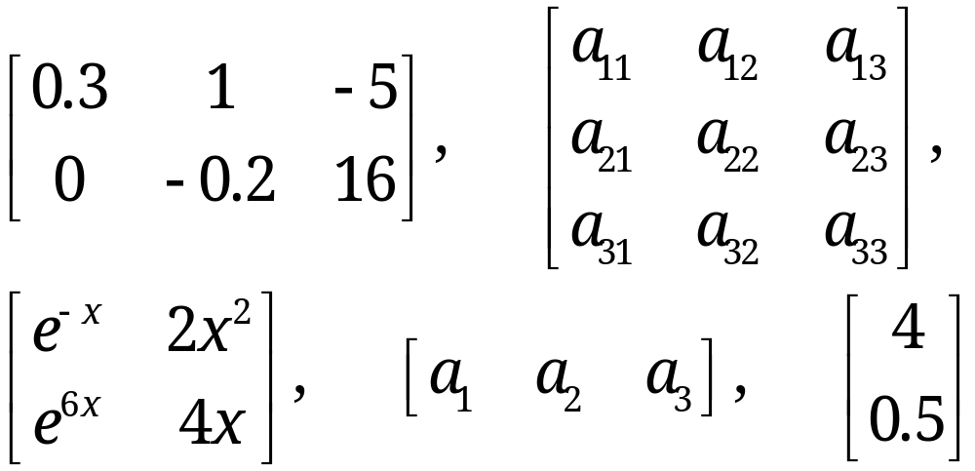
7.1 Matrices, Vectors: Addition and Scalar Multiplication
A matrix is a rectangular array of numbers or functions which we enclose in brackets
Examples of matrices
(1)
The numbers (or functions) are called entries, or less commonly, elements of the matrix
Section 7.1 p<number>

Slide 5
7.1 Matrices, Vectors: Addition and Scalar Multiplication
Rows and columns of a matrix
  Rows: the horizontal lines of entries
  Columns: the vertical lines of entries
Location indices of entries
  Each entry in a matrix is uniquely identified by two indices: the row index (i.e., the number of the row) and the column index (i.e., the number of the column)
  Example: a₂₃ (read “a two three”) is in row 2 and column 3
Square matrix and vector
  Square matrix: matrix with equal rows and columns
  Vector: matrix with a single row (row vector) or a single column (column vector)
Matrices are very useful for storing and processing data in applications
Section 7.1 p<number>

Slide 6
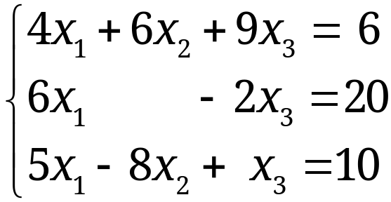

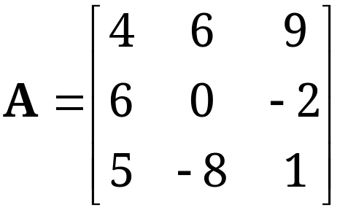
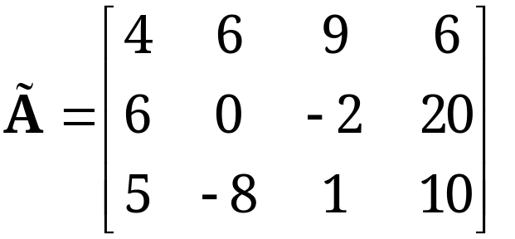
7.1 Matrices, Vectors: Addition and Scalar Multiplication
Example 1: Linear Systems, a Major Application of Matrices
We are given a system of linear equations, briefly a linear system, such as
where x₁, x₂, x₃ are the unknown variables.
We can form the coefficient matrix A and the augmented matrix of the system
Section 7.1 p<number>

Slide 7
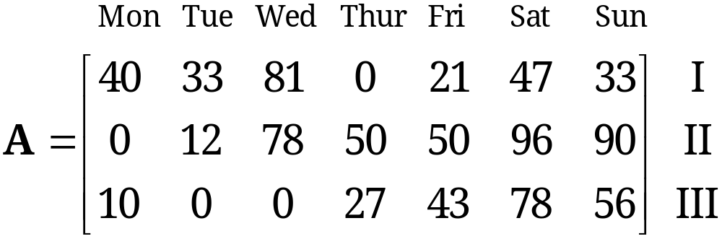
7.1 Matrices, Vectors: Addition and Scalar Multiplication
Example 2: Sales Figures in Matrix Form
Sales figures for three products, I, II, III, in a store on Monday, Tuesday, ∙ ∙ ∙ , Sunday for each week can be arranged in a matrix:
If the company has 10 stores, we can set up 10 such matrices, one for each store. Then, by adding corresponding entries of these matrices, we can get a matrix showing the total sales of each product in each day
Any other data which can be stored in matrix form?
Section 7.1 p<number>

Slide 8
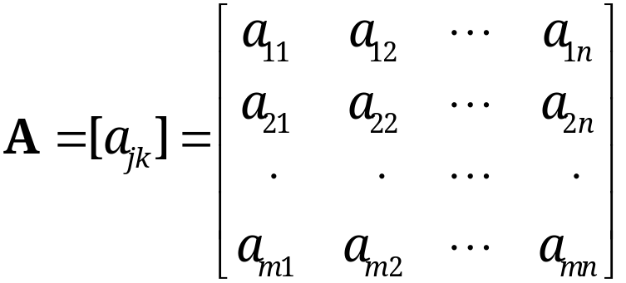
7.1 Matrices, Vectors: Addition and Scalar Multiplication
General Concepts and Notations
Denote matrices by capital boldface letters A, B, C, … , or by writing the general entry in brackets, A = [a_{jk}], and so on
By an m × n matrix (read m by n matrix) we mean a matrix with m rows and n columns
m × n is called the size of the matrix
  Question: what are the sizes of the matrices in (1)?
An m × n matrix is of the form
(2)
Remember: rows always come first!
Section 7.1 p<number>

Slide 9
7.1 Matrices, Vectors: Addition and Scalar Multiplication
General Concepts and Notations (continued)
Entries of a matrix
  Each entry in (2) has two subscripts: the first is the row number and the second is the column number
  a_{jk} represents the entry in row j and column k
Square matrix
  If m = n, we call A an n × n square matrix
  The diagonal containing the entries a₁₁, a₂₂, … , a_{nn} of an n × n square matrix is called the main diagonal
  Square matrices are very important, as we shall see later
Rectangular matrix
  A matrix of any size m × n is called a rectangular matrix
Section 7.1 p<number>

Slide 10
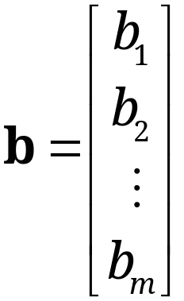
7.1 Matrices, Vectors: Addition and Scalar Multiplication
Vectors
A vector is a special matrix with only one row or column. Its entries are called the components of the vector
We denote vectors by lowercase boldface letters a, b, …, or by its general component in brackets, a = [a_{j}], and so on
A row vector is a 1×n matrix, of the form
a = [a₁, a₂, ∙ ∙ ∙ , a_{n}]
A column vector is an m×1 matrix, of the form
Section 7.1 p<number>

Slide 11
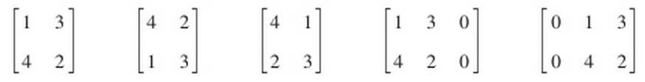
7.1 Matrices, Vectors: Addition and Scalar Multiplication
Definition
Equality of Matrices
Two matrices A = [a_{jk}] and B = [b_{jk}] are equal, written A = B, if and only if
  they have the same size, and
  their corresponding entries are ALL equal, that is,
  a₁₁ = b₁₁, a₁₂ = b₁₂, and so on.
Matrices that are not equal are called different matrices. Thus, matrices of different sizes are always different.
The following matrices are all different. Explain why.
Section 7.1 p<number>

Slide 12
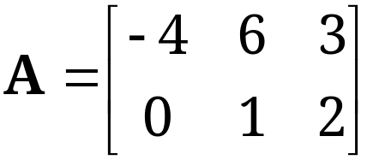
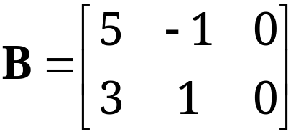
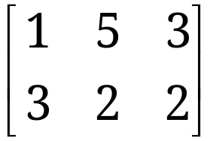

7.1 Matrices, Vectors: Addition and Scalar Multiplication
Definition
Addition of Matrices
The sum of two matrices A = [a_{jk}] and B = [b_{jk}] of the same size is written by A + B and has the entries a_{jk} + b_{jk} obtained by adding the corresponding entries of A and B.
Remarks
Matrices of different sizes cannot be added!
Addition of vectors is a special case of addition of matrices
Exercise
If and , then
Section 7.1 p<number>

Slide 13
7.1 Matrices, Vectors: Addition and Scalar Multiplication
Definition
Scalar Multiplication (Multiplication by a Number)
The product of any m × n matrix A = [a_{jk}] and any scalar c (number c) is written as cA and is the m × n matrix cA = [ca_{jk}] obtained by multiplying each entry of A by c.
Remarks
(-1) A is simply written as –A and is called the negative of A. Similarly, (-k) A is written as –kA
A + (-B) is written as A – B and is called the difference of A and B
Scalar multiplication of a vector is a special case of scalar multiplication of a matrix
Section 7.1 p<number>

Slide 14



7.1 Matrices, Vectors: Addition and Scalar Multiplication
Rules for Matrix Addition and Scalar Multiplication
From the familiar laws for the addition of numbers we obtain similar laws for the addition of matrices of the same size m × n, namely,
(3)
Here, 0 denotes the zero matrix (of size m × n), i.e., the
m × n matrix with all entries zero. If m = 1 or n = 1, this is a
zero vector.
Matrix addition is commutative [by (3a)] and associative [by (3b)].
Section 7.1 p<number>

Slide 15
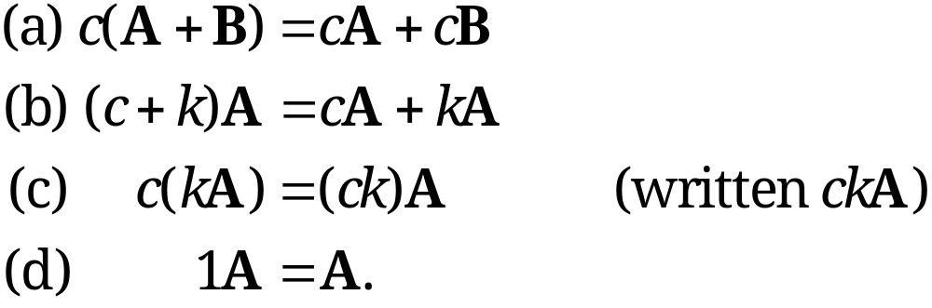
7.1 Matrices, Vectors: Addition and Scalar Multiplication
Rules for Matrix Addition and Scalar Multiplication
(continued)
Similarly, for scalar multiplication we obtain the rules
(4)
Section 7.1 p<number>

Slide 16
7.2 Matrix Multiplication

Slide 17
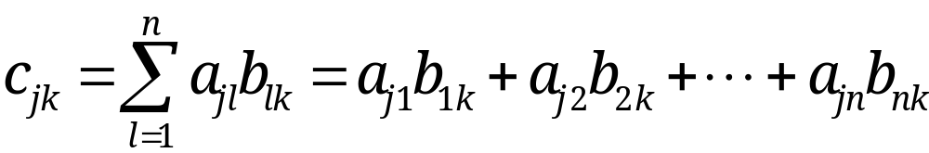
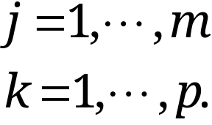
7.2 Matrix Multiplication
Definition
Multiplication of a Matrix by a Matrix
The product C = AB (in this order) of an m × n matrix A = [a_{jk}] times an r × p matrix B = [b_{jk}] is defined if and only if r = n, and the product is the m × p matrix C = [c_{jk}] with entries
(1)
Remark: The condition r = n means that the columns of the first matrix, A, must equal the rows of the second matrix, B. A diagram of sizes that shows when matrix multiplication is possible is as follows:
A B = C
[m × n] [n × p] = [m × p].
Section 7.2 p<number>

Slide 18
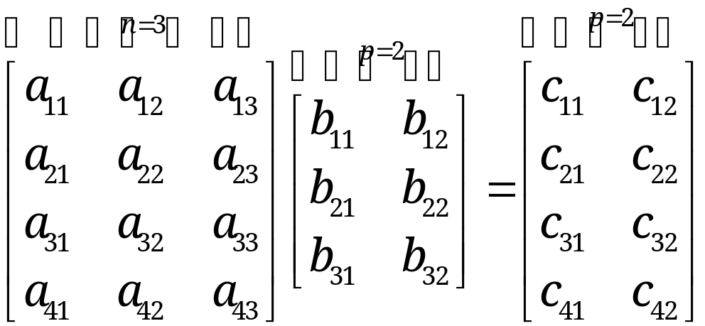
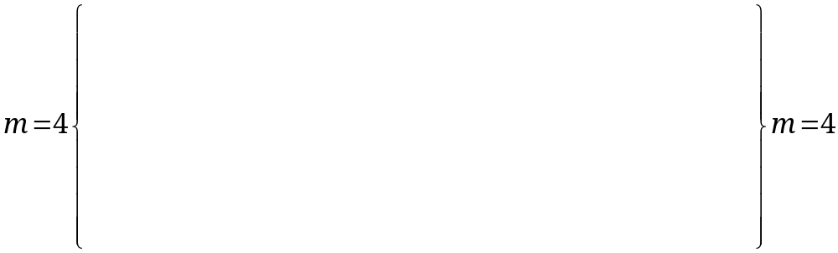
7.2 Matrix Multiplication
The entry c_{jk} in (1) is obtained by multiplying each entry in the jth row of A by the corresponding entry in the kth column of B and then adding these n products. For instance, c₂₁ = a₂₁b₁₁ + a₂₂b₂₁ + … + a_{2n}b_{n1}, and so on.
One calls this briefly a multiplication of rows into columns
For n = 3, this is illustrated by
where we shaded the entries that contribute to the
calculation of entry c₂₁ just discussed.
Section 7.2 p<number>

Slide 19
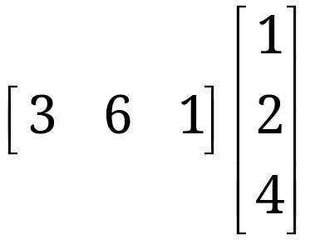
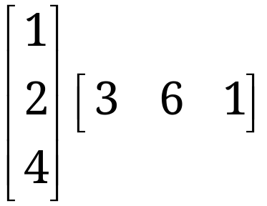
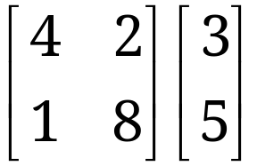
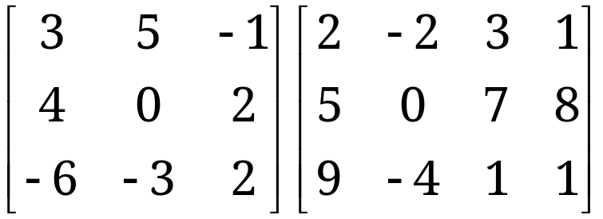
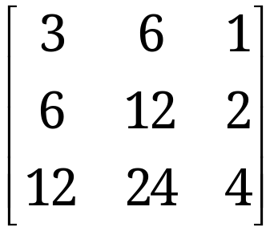
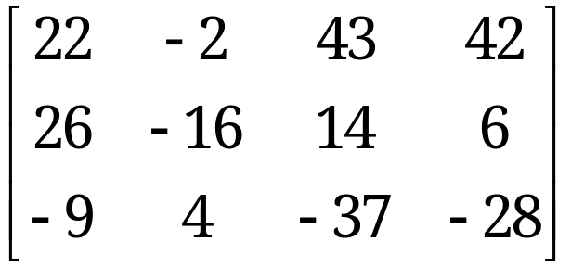
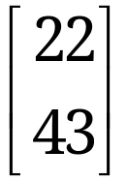

7.2 Matrix Multiplication
EXAMPLES 1 — 3
Matrix Multiplication
Calculate the following matrix multiplications
Solution
Section 7.2 p<number>

Slide 20
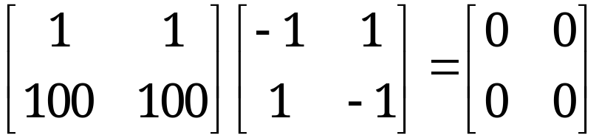
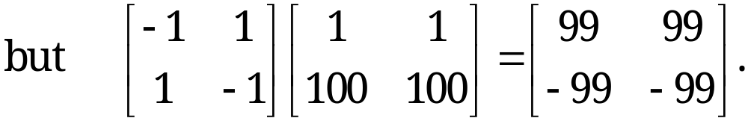
7.2 Matrix Multiplication
EXAMPLE 4 CAUTION!
Matrix Multiplication Is Not Commutative,
AB ≠ BA in General
This is illustrated by Exercises 1—3, where one of the two products is not even defined, or where the two products have different sizes
This also holds for square matrices. For instance,
It is interesting to observe that AB = 0 DOES NOT necessarily imply BA = 0 or A = 0 or B = 0.
Section 7.2 p<number>

Slide 21


7.2 Matrix Multiplication
In matrix products, the order of matrices must always be observed very carefully
Rules for matrix multiplication
(2)
provided A, B, and C are such that the expressions on the left are defined and k is any scalar
(2b) is called the associative law; (2c) and (2d) are called the distributive laws
Section 7.2 p<number>

Slide 22
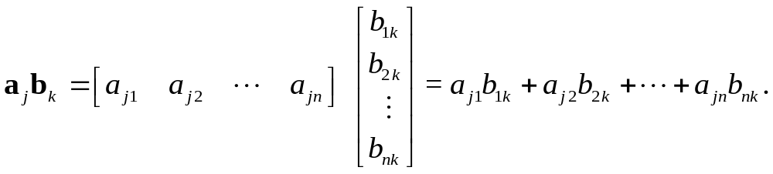
7.2 Matrix Multiplication
Expressing Matrix Multiplication More Compactly
The product C = AB of an m × n matrix A times an n× p matrix B is the m × p matrix C = [c_{jk}] with entries
(3) c_{jk} = a_{j} b_{k}, j=1, ∙ ∙ ∙, m; k=1, ∙ ∙ ∙, p
where a_{j} is the jth row vector of A and b_{k} is the kth column vector of B, so that in agreement with (1),
Section 7.2 p<number>

Slide 23
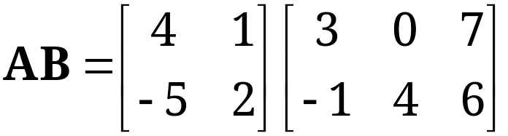
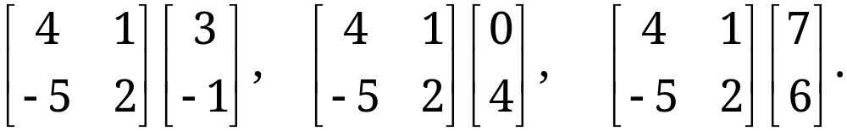
7.2 Matrix Multiplication
Parallel processing of products C = AB on the computer
With A being given, decompose B in terms of its column vectors, and compute the product column by column,
AB = A[b₁ b₂ … b_{p}] = [Ab₁ Ab₂ … Ab_{p}].
Assign columns of B to different processors (individually or several to each processor) to simultaneously compute the columns of the product matrix Ab₁, Ab₂, etc.
EXAMPLE 6
To obtain , from (5), calculate
Section 7.2 p<number>

Slide 24
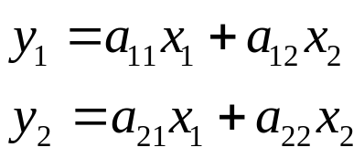
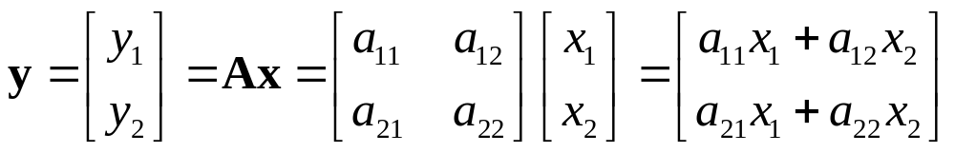
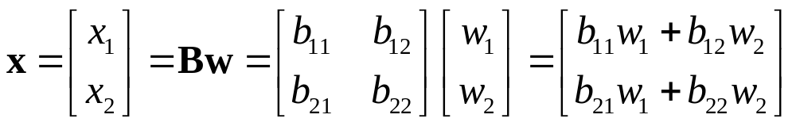
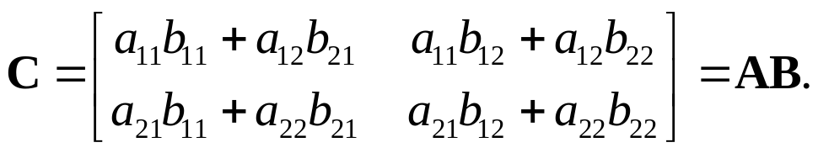
7.2 Matrix Multiplication
Motivation of Multiplication by Linear Transformations
Consider linear transformation below
(6*)
In vector form we can rewrite (6*) as
(6)
Now consider another linear transformation
(7)
Combining (6) and (7), we obtain y = A(Bw) = Cw, where
Section 7.2 p<number>

Slide 25
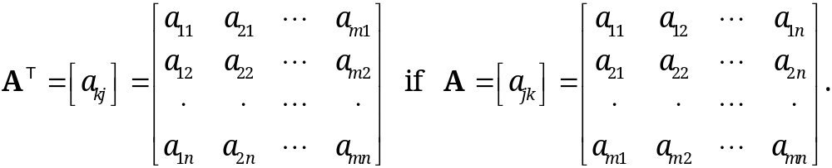
7.2 Matrix Multiplication
Definition
Transposition of Matrices and Vectors
The transpose of an m × n matrix A = [a_{jk}] is the n × m matrix A^{T} (read A transpose) that has the first row of A as its first column, the second row of A as its second column, and so on
Mathematically, A^{T} is written as
(9)
As a special case, transposition converts row vectors to column vectors and conversely
Section 7.2 p<number>

Slide 26
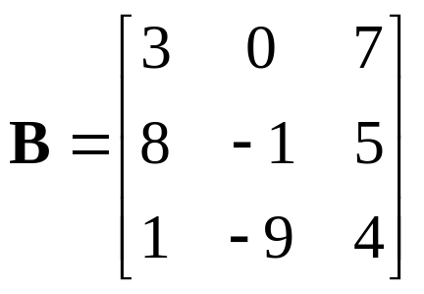
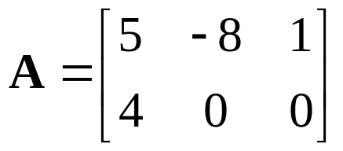
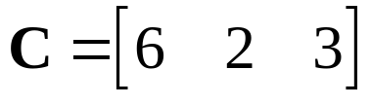
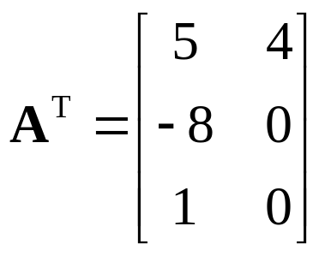
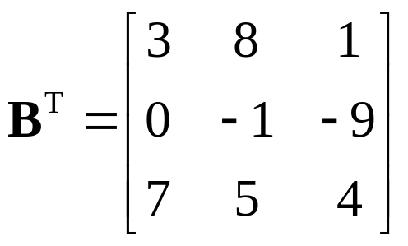
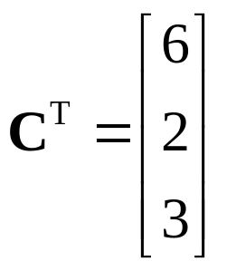
7.2 Matrix Multiplication
EXAMPLE 7
Transposition of Matrices and Vectors
Find the transposition of the following matrices
Solution
What are (A^{T})^{T}, (B^{T})^{T}, and (C^{T})^{T}?
Section 7.2 p<number>

Slide 27




7.2 Matrix Multiplication
Transposition gives us a choice in that we can work either with the matrix or its transpose, whichever is more convenient
Rules for matrix transposition
(10)
CAUTION! Note that in (10d) the transposed matrices are multiplied in reversed order.
Section 7.2 p<number>

Slide 28
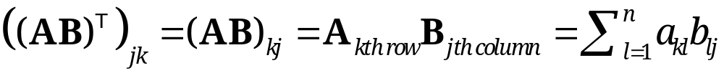
7.2 Matrix Multiplication
Proof of (10) (d)
By definition of equality of matrices, we need to prove
  The matrices (AB)^{T} and B^{T}A^{T} have the same size;
  The corresponding entries of (AB)^{T} and B^{T}A^{T} are ALL the same.
1) is true since both matrices have the size p×m
2) is also true since for any j=1,…p and k=1,…m, we have
After combining the above arguments, we have completed the proof.
Section 7.2 p<number>

Slide 29
7.2 Matrix Multiplication
Special Matrices
Symmetric and Skew-Symmetric Matrices
Symmetric matrices are square matrices whose transpose equals the matrix itself
(11a) A^{T} = A (thus a_{kj} = a_{jk}) Symmetric Matrix
Skew-symmetric matrices are square matrices whose transpose equals minus the matrix
(11b) A^{T} = −A (thus a_{kj} = −a_{jk}, hence a_{jj} = 0) Skew-Symmetric
Matrix
Any square matrix A can be decomposed as sum of a symmetric matrix A_{sym} and a skew-symmetric matrix A_{skew}
Section 7.2 p<number>

Slide 30
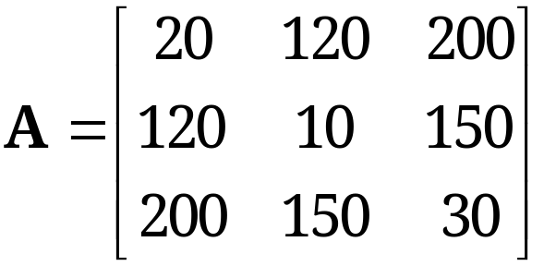
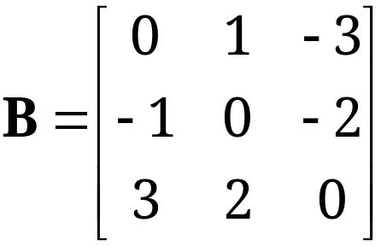
7.2 Matrix Multiplication
EXAMPLE 8
Symmetric and Skew-Symmetric Matrices
Are the following matrices symmetric or skew-symmetric?
If a company has three building supply centers C₁, C₂, C₃, and let matrix A show: a_{jj} the cost of handling 1000 bags of cement at center C_{j}, and a_{jk} (j ≠ k) the cost of shipping 1000 bags from C_{j} to C_{k}. Question: under what condition will A be a symmetric matrix?
Answer: shipping costs in the opposite directions are the same!
Section 7.2 p<number>

Slide 31
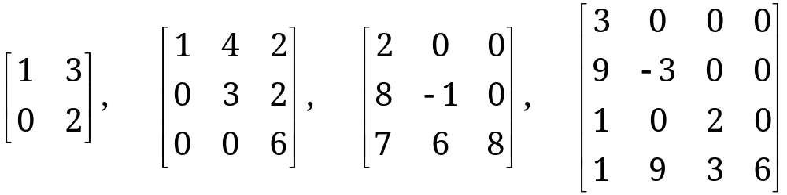
7.2 Matrix Multiplication
Triangular Matrices
Upper triangular matrices are square matrices whose entries below the main diagonal are ALL zero
Lower triangular matrices are square matrices whose entries above the main diagonal are ALL zero
EXAMPLE 9
Upper and lower triangular matrices
Section 7.2 p<number>

Slide 32
7.2 Matrix Multiplication
Diagonal, Scalar, Unit Matrices
Diagonal matrices are square matrices whose entries except the main diagonal are ALL zero
Scalar matrices are diagonal matrices whose main diagonal entries are ALL equal
  For scalar matrix S with diagonal entry c, and for any square matrix A of the same size, we have
(12) AS = SA = cA.
Unit (or identity) matrix, denoted by I_{n} or simply by I, is a scalar matrix whose main diagonal entries are ALL 1
  For I, formula (12) becomes
(13) AI = IA = A.
Section 7.2 p<number>

Slide 33
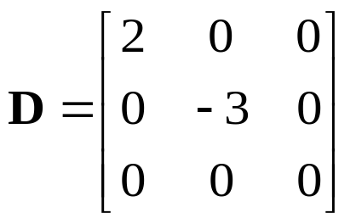
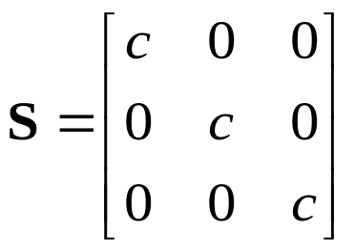
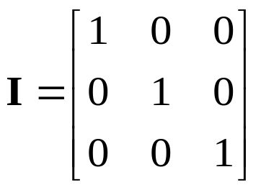
7.2 Matrix Multiplication
EXAMPLE 10
Diagonal Matrix D. Scalar Matrix S. Unit Matrix I
Section 7.2 p<number>

Slide 34
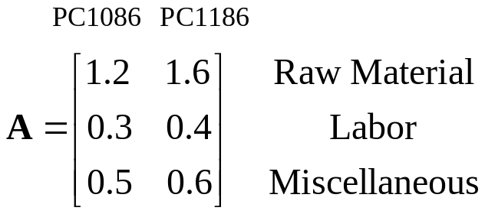
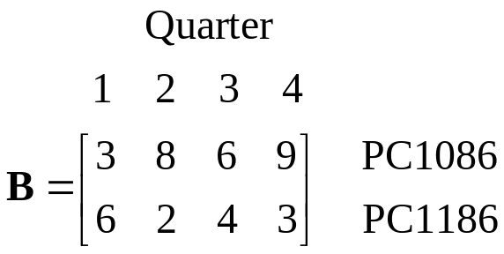
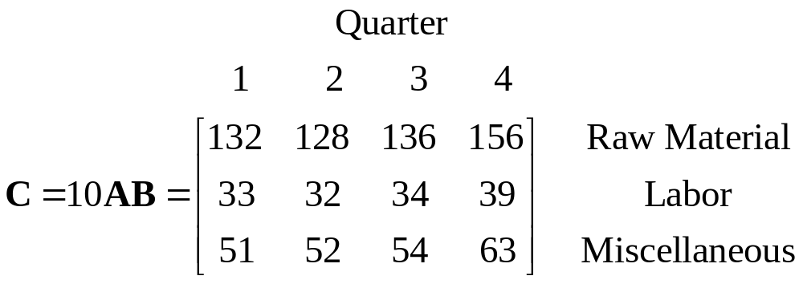
7.2 Matrix Multiplication
Some Applications of Matrix Multiplication
EXAMPLE 11 Computer Production. Matrix Times Matrix.
Supercomp Ltd produces two computer models PC1086 and PC1186. The matrix A shows the cost per computer (in thousand dollars) and B the production figures for the year 2010 (in 10, 000 units).
Question: find a matrix C showing the cost per quarter (in million dollars) for material, labor, and miscellaneous.
Solution
Section 7.2 p<number>

Slide 35
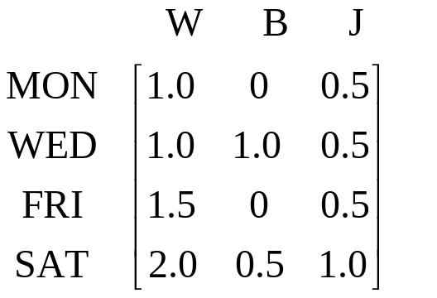

EXAMPLE 12
Weight Watching. Matrix Times Vector
7.2 Matrix Multiplication
Suppose that in a weight-watching program, a person of 185 lbs burns 350 cal/hr in walking, 500 cal/hr in bicycling, and 950 cal/hr in jogging. Bill, weighing 185 lbs, plans to exercise according to the matrix below.
Question: what are Bill’s calorie burnings on MON, WED, FRI, and SAT?
Solution
Section 7.2 p<number>

